Slide 1
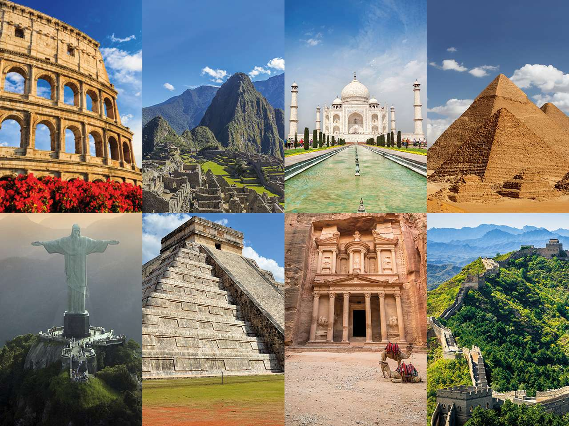
Wonders of the world
Savonin Maxim ET-211

Slide 2
Topic: Wonders of the world
Tell about the best wonder of the world.

Slide 3
Plan
1)Tell about some Wonders of the world
2)Tell about the best wonder of the world

Slide 4
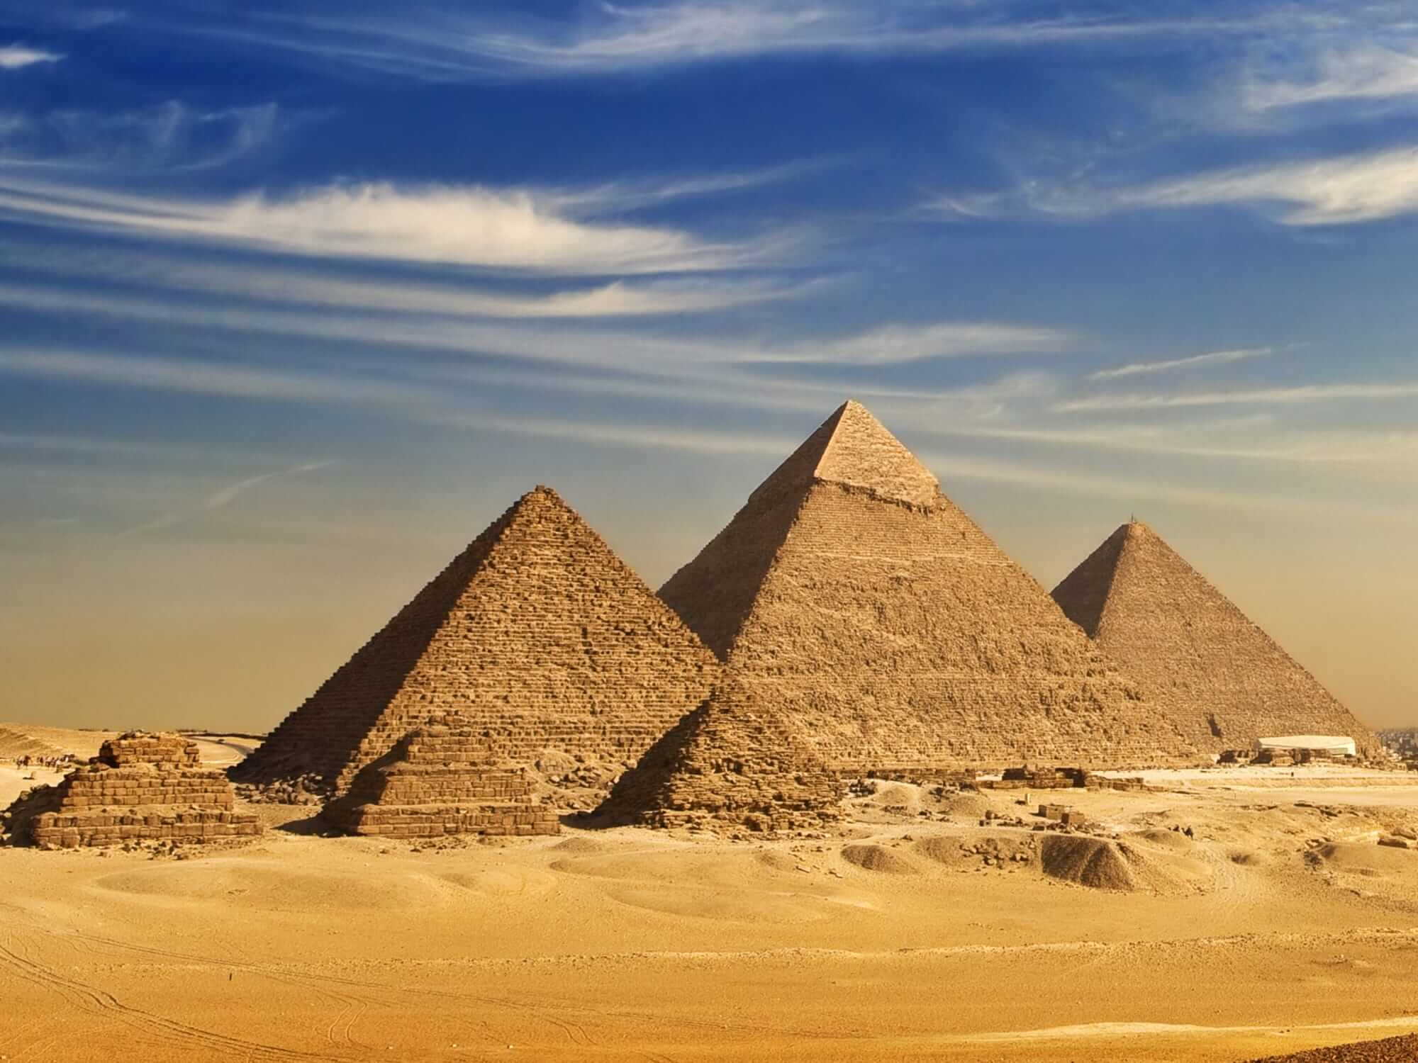
Pyramids of Egypt

Slide 5
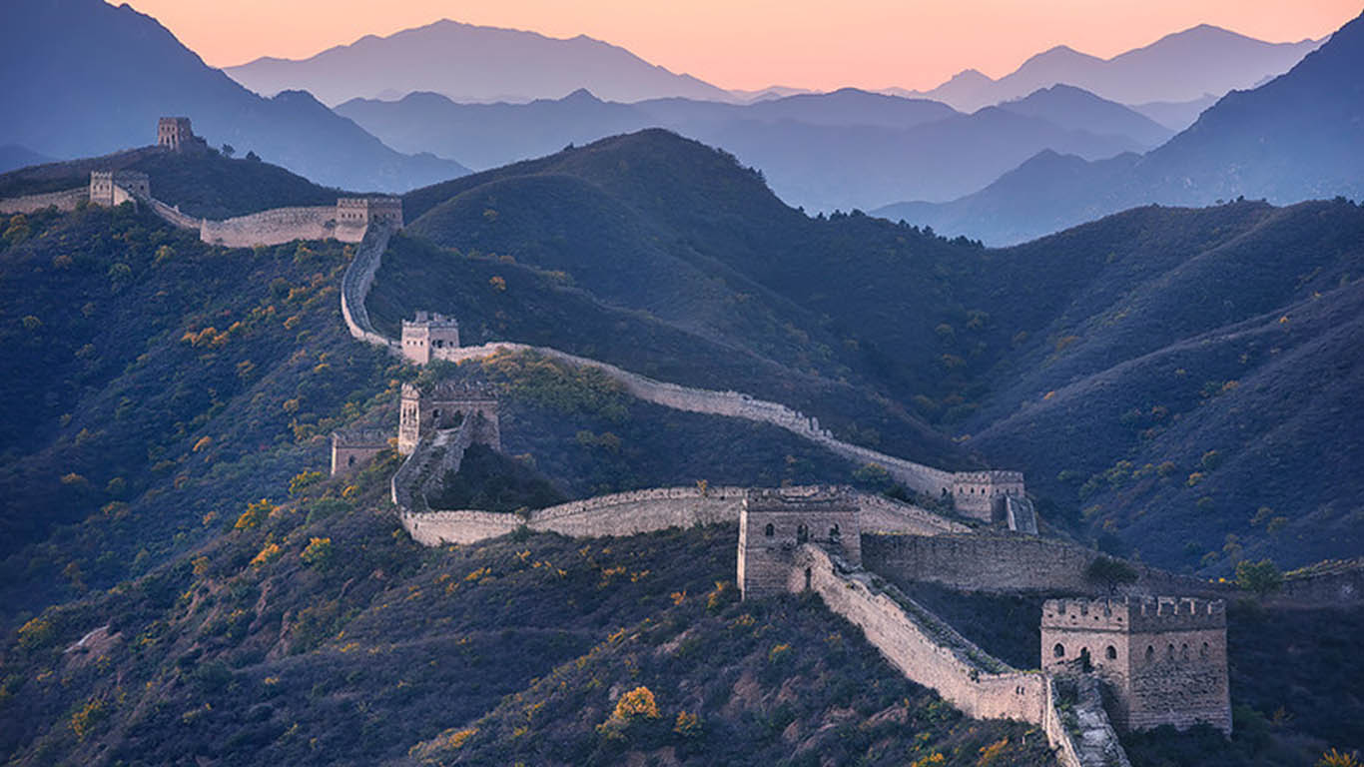
Great Wall of China

Slide 6
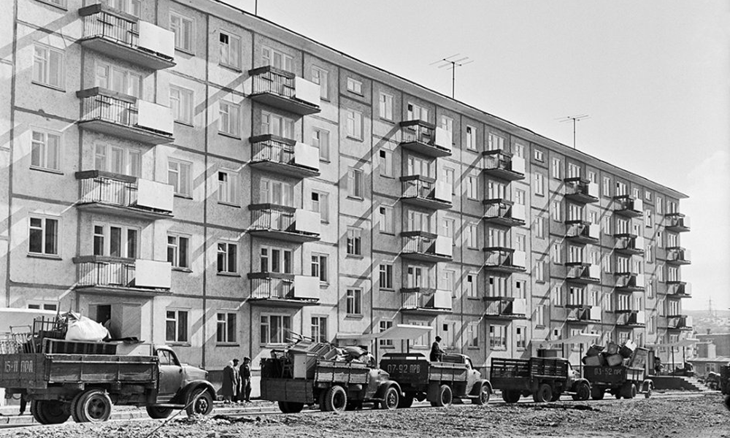
Beautiful Khrushchovki.

Slide 7
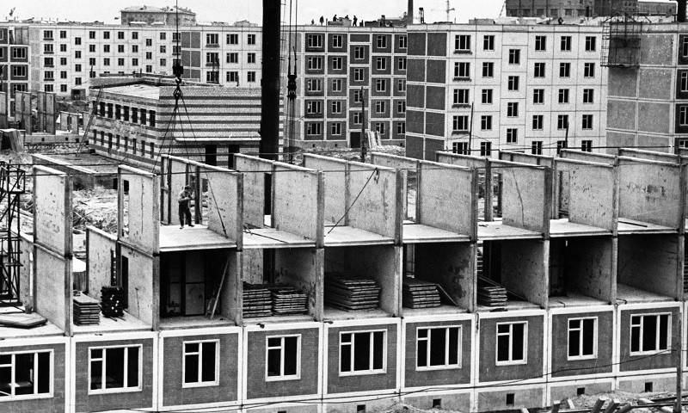
Construction of Khrushchovki.

Slide 8
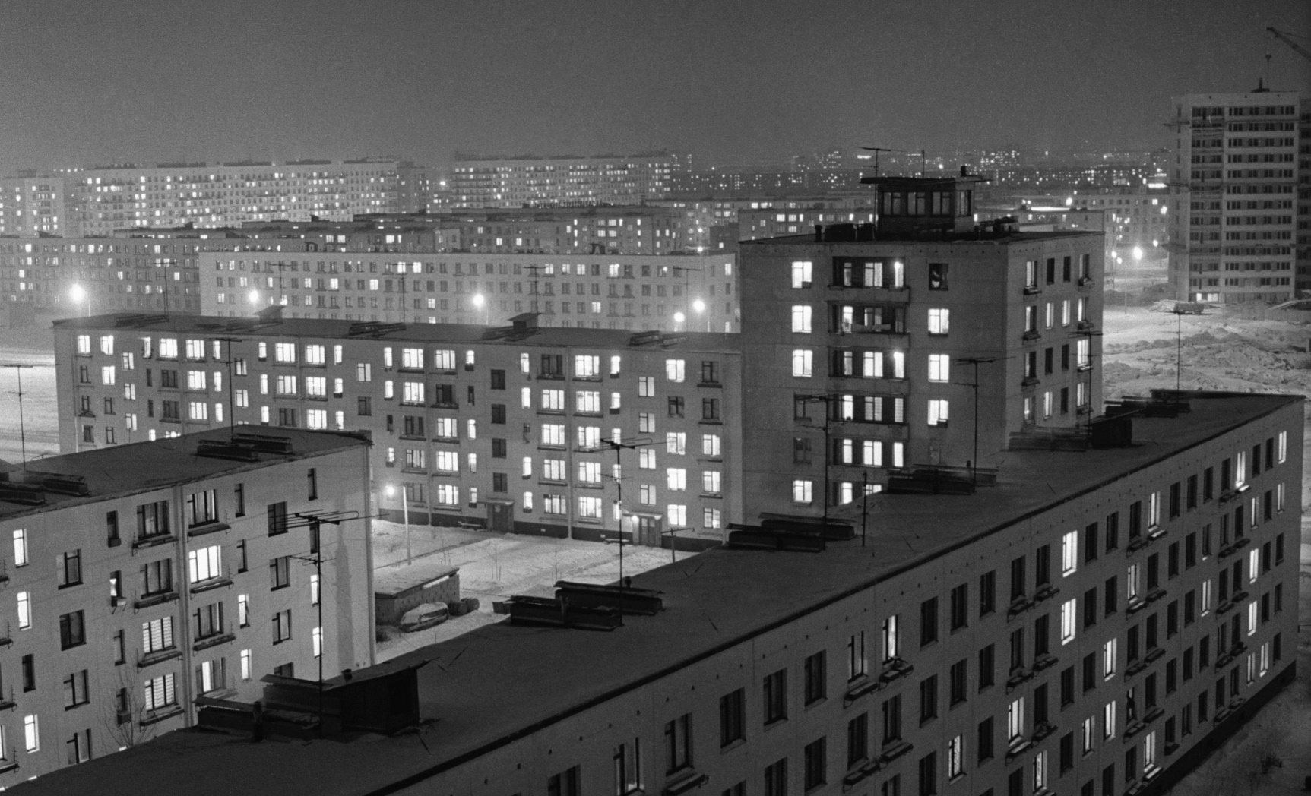
Why Khrushchovka

Slide 9
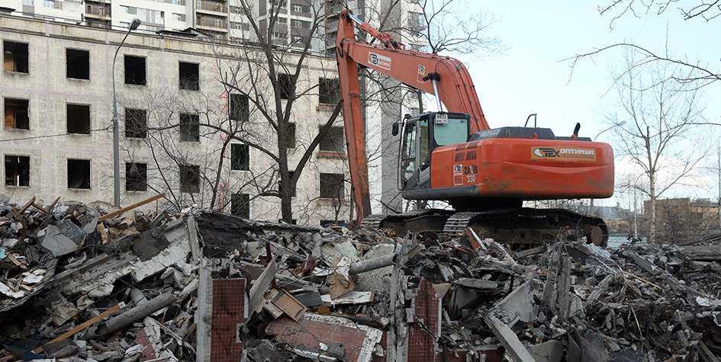
Khrushchovki now

Slide 10
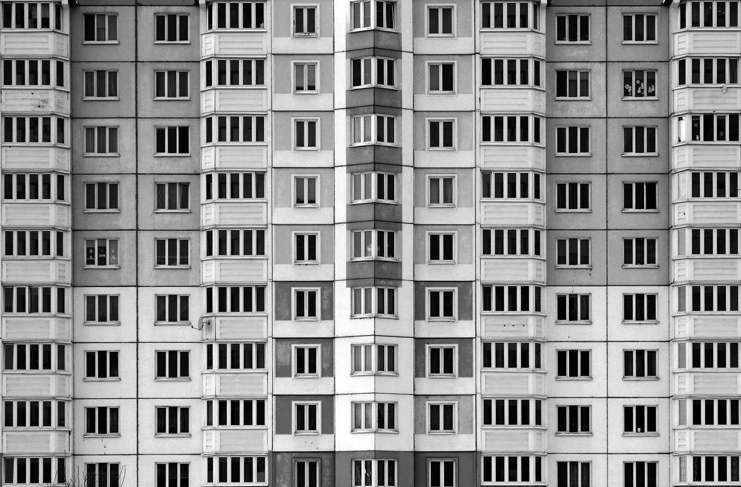
Questions
When were they built?
How many floors in Khrushchovka?
Are they popular right now?

Slide 11
Conclusion
I studied the topic wonders of the world.

Slide 12
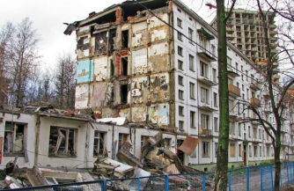
Thank you for your attention

